Slide 1
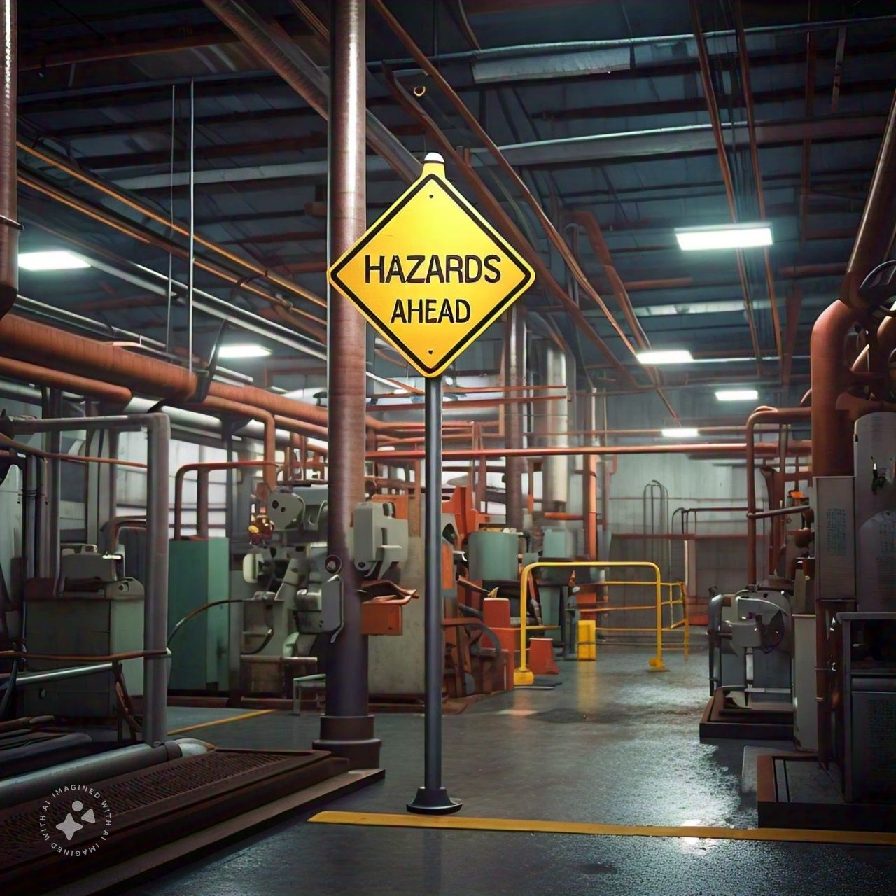

MODULE 5 HAZARD IDENTIFICATION AND ANALYSIS

Slide 2
SYLLABUS
Hazard and risk, Types of hazards
Classification of Fire, Types of Fire extinguishers, fire explosion and toxic gas release
Structure of hazard identification and risk assessment.
Identification of hazards: Inventory analysis, Fire and explosion hazard rating of process plants.
The Dow Fire and Explosion Hazard Index
Preliminary hazard analysis, Hazard and Operability study (HAZOP)) methodology, criticality analysis, corrective action and follow-up.
Control of Chemical Hazards, Hazardous properties of chemicals
Material Safety Data Sheets (MSDS).

Slide 3

HAZARDS
HAZARD AND RISKS
01
Hazard is a source or a situation with potential to cause harm in terms of human injury or ill health, damage to property or environment or both.
Hazards are identified in the performance of various activities, storage and handling of materials, and operation and maintenance of plants and equipment’s.
Hazard control is that function which is oriented towards recognizing, evaluating and working towards eliminating hazards and destructive effects found at the work-place.
01
02
RISKS
A hazard is something that has the potential to cause harm while risk is the likelihood of harm taking place, based on exposure to that hazard. A hazard is something that can cause harm, e.g. electricity, chemicals, working up a ladder, noise, a keyboard, a bully at work, stress, etc.
A risk is the chance, high or low, that any hazard will actually cause somebody harm
03

Slide 4
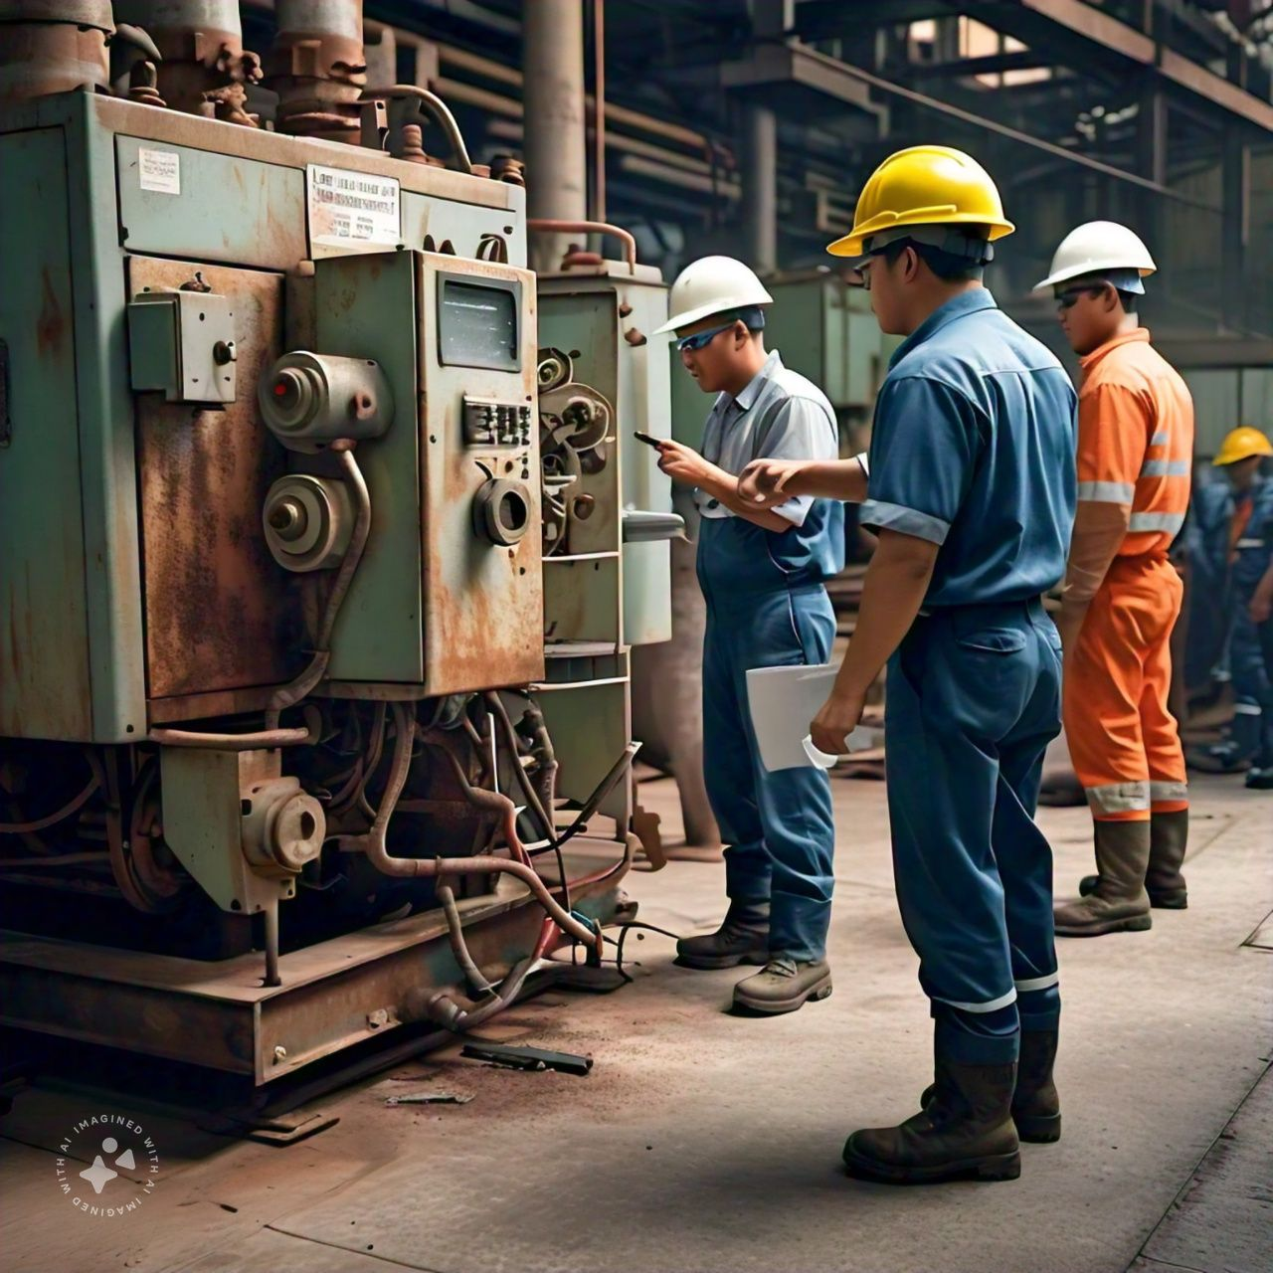
HAZARD AND RISKS
Inspect Workplaces
01
Regularly inspect workplaces for potential hazards, encouraging active participation from employees to identify unsafe conditions and practices to mitigate risks effectively.
Employ Risk Assessments
02
Utilize comprehensive risk assessment tools like the Risk Matrix to prioritize hazards based on severity and likelihood, guiding necessary control measures for workplace safety.
Train Employees
03
Conduct training sessions on hazard recognition and response strategies, ensuring all employees understand the importance of safety protocols and emergency procedures in the workplace.

Slide 5


Understanding Hazard and Risk
Hazard Identification
01
Regularly conduct inspections and engage workers in reporting potential hazards in the workplace.
Risk Assessment
02
Use tools like Risk Matrix and FMEA to prioritize hazards based on their severity and likelihood.
Emergency Planning
03
Develop and implement plans for emergency scenarios and non-routine tasks to mitigate identified risks.

Slide 6
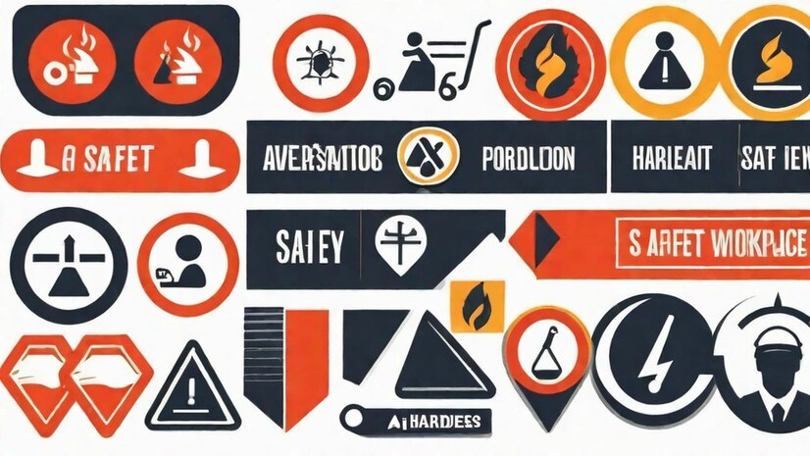
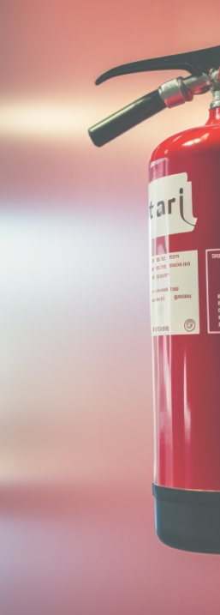
Types of Hazards: Overview
Mechanical
01
Implement regular equipment maintenance to prevent accidents caused by unguarded machinery and tools.
Electrical
02
Ensure proper insulation and protective measures for all electrical installations to reduce risks of electric shocks.
Chemical
03
Conduct regular training on safe handling and storage procedures for hazardous chemicals to prevent health risks.
Fire
04
Install appropriate fire extinguishers and conduct regular drills to educate employees on fire emergency procedures.

Slide 7



MECHANICAL HAZARDS
01
These are responsible for the majority of the accidents in work situations, therefore every workplace and equipment should be properly examined for identifying mechanical hazards and for taking mitigating measures.
02
Common sources of mechanical hazards are:
(a) Unguarded or inadequately guarded moving parts or pits etc.
(b) Machine tools, hand tools, handling materials, lifting and other appliances.
(c) Improper ventilation, unsafe dress or apparel etc.
(d) Improper use of tools.
03
04

Slide 8





Mechanical Hazards: Risks and Examples
Problem Faced
Inadequate machine guarding leads to workplace injuries.
Solution Offered
Implement effective safety guards and training protocols.
Benefits
Enhanced worker safety and reduced accident rates.

Slide 9

ELECTRICAL HAZARDS
These may be due to contact of body with wire, cable or rail or from stroke of lightening.
The immediate effect of this is shock which may be relatively mild or severe so as to cause death (electrocution) depending upon the strength of the current and/or the path it takes passing the earth through the body.
Another result is burning and the burns may be severe and deep, especially with higher voltage.
02
02
03
04

Slide 10
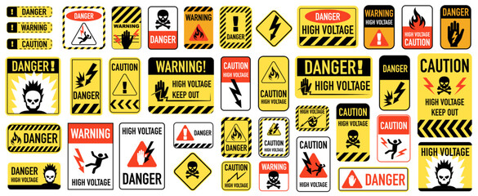


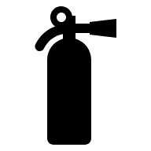
Causes of the electric hazards may be of the following types:
Electric shocks may be caused by an exposed live conductor or a faulty piece of equipment.
A mobile crane boom, a man carrying aluminium ladder, or vertical metal bars etc. can come in contact with overhead power lines, electric crane rails, open- faced substation switchboards etc.
Other causes may be unskilled electricians, improper, instructions, defective wiring which
may cause short circuit, poor installations, misuse or overloading.
Ageing and attack by foreign materials causes insulation failures which causes electrical
fires or cases of electrocution..

Slide 11
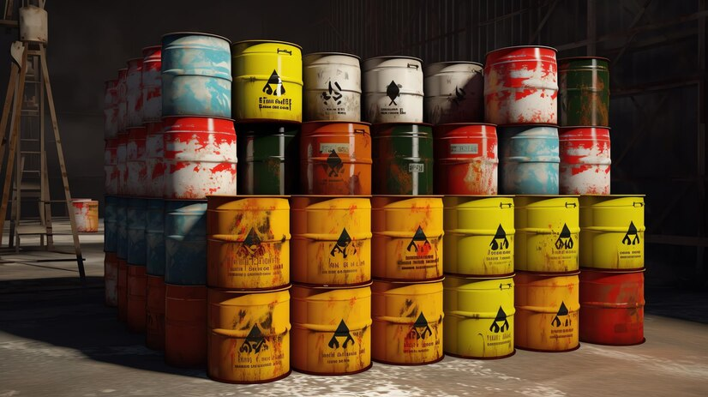
CHEMICAL HAZARDS
The usage of chemicals with the resultant hazardous gases, vapours and fumes is one of the
most dangerous industries.
02
The effects of noxious gases are:
Simple asphyxiants, e.g., nitrogen gas, methane gas, carbon dioxide.
Chemical osphysciants, e.g., carbon monoxide, hydrogen- sulphide, hydro-cyanic acid.
Irritant gases, e.g., nitrogen dioxide or peroxide, flourine, hydrogen flouride, sulphur
dioxide, ammonia.
Organic metallic gases, e.g., assenic hydride.
Inorganic metallic gases.
02
03
04

Slide 12


CLASSES OF FIRE

Slide 13


While fire can seem like one big threatening force, it's important to know that there are actually
several classes of fires. A fire's class can determine how quickly it burns, how dangerous it is,
and the best way to suppress or put it out. The 5 different classes of fires each have their own
best approach to put them out safely and effectively

Slide 14
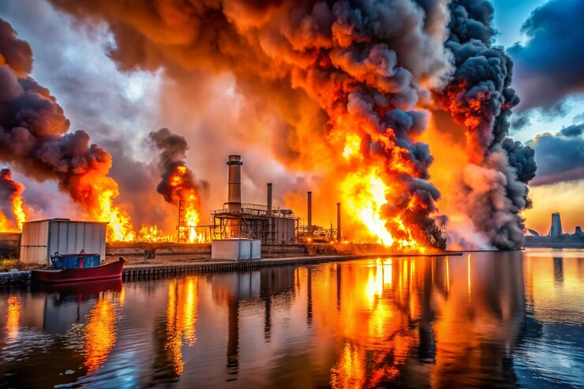
Class A: solid materials such as wood or paper, fabric, and some plastics
Class B: liquids or gas such as alcohol, ether, gasoline, or grease
Class C: electrical failure from appliances, electronic equipment, and wiring
Class D: metallic substances such as sodium, titanium, zirconium, or magnesium
Class K: grease or oil fires specifically from cooking

Slide 16
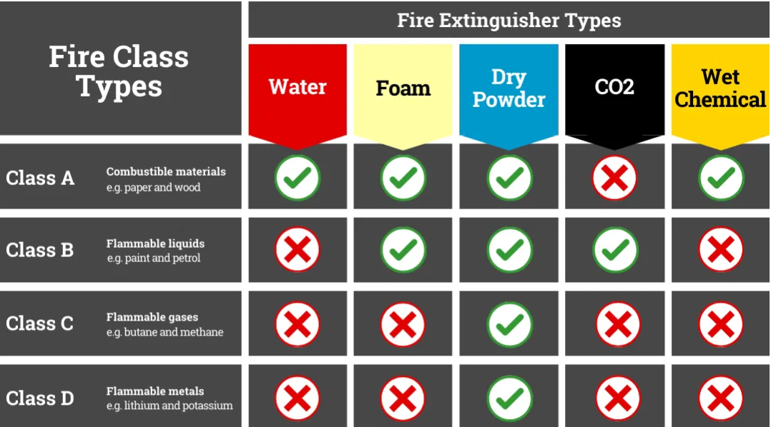


Slide 17
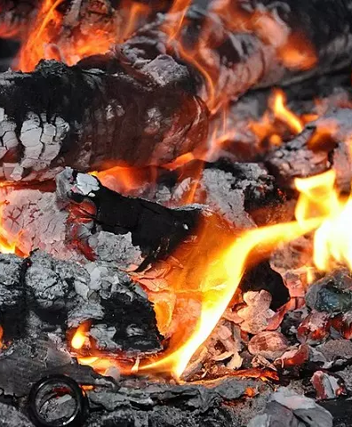
CLASS A FIRE
Class A fires are the most common type of fire.
They are produced from common combustible materials including wood, paper, fabric, rubber, and plastic. Class A fires have relatively low ignition temperatures, and once the fuel or oxygen has been depleted, the fire will burn out.
A garbage fire is one example of Class A fires.
Generally speaking, if the fire leaves ash behind, it's likely a Class A Fire.
Water and foam agents are most often used when fighting Class A fires.

Slide 18
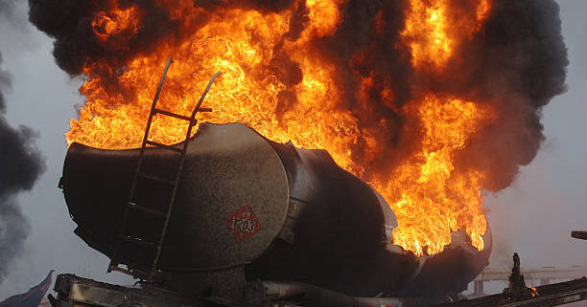
CLASS B FIRE
Class B fires occur when flammable liquids or gases such as alcohol, kerosene, paint, gasoline, methane, oil-based coolants, or propane ignite.
Class B fires are most common in industrial settings, but they may also occur in residential or commercial settings.
Class B fires have a low flashpoint, which means they burn easily at any temperature if exposed to a fire source.
Class B fires also spread rapidly and produce a thick black smoke as they burn.
Water is not effective when dealing with Class B fires. Instead, Carbon Dioxide (CO2) or dry chemical agents are often used to fight these fires

Slide 19
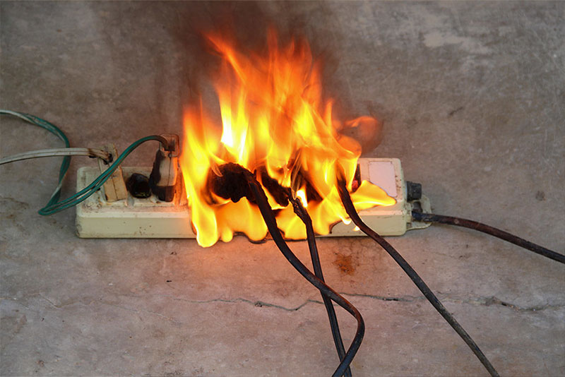
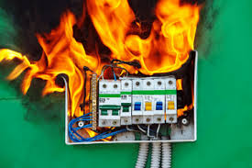
CLASS C FIRE
Class C fires are those fires that have live electrical currents or electrical equipment as a source of fuel.
Such fuel sources could include electric tools, appliances, motors, and transformers.
Class C fires are most common in industrial settings that deal with energy or electrically powered equipment, like wind turbines. However, Class C fires can also occur in commercial or residential settings due to issues like faulty wiring.
Electrical fires cannot be fought with water-in fact, it can make it worse.
Instead, a nonconductive chemical agent, including clean agents, should be used to put out the flames.

Slide 20

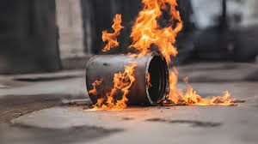
CLASS D FIRE
Class D fires describe those fires that occur with a ombustible metal fuel source.
Common combustible metals include aluminum, lithium, magnesium, potassium, titanium, and zirconium.
These types of combustible metals are most often used in laboratories and in manufacturing, so the biggest danger for Class D fires occurs in these industries.
Water can cause some combustible metals to explode, so it should not be used to fight Class D fires.
Instead, dry powder agents can be used to absorb heat and smother the flames by blocking off the fire's oxygen supply.

Slide 21

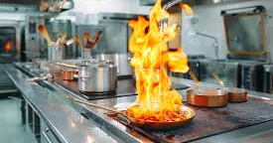
CLASS K FIRE
Finally, Class K fires are cooking fires that occur as a result of the combustion of a cooking liquid like grease, oil, vegetable fat, or animal fat. Class K fires are technically a type of liquid fire, but they are separated out as their own class because of their unique setting.
Class K fires are most common in the food service and restaurant industry, but can occur in any kitchen.
Like other liquid fires, water should not be sprayed onto Class K fires.
Instead, wet chemical agents are the best method to use.

Slide 22
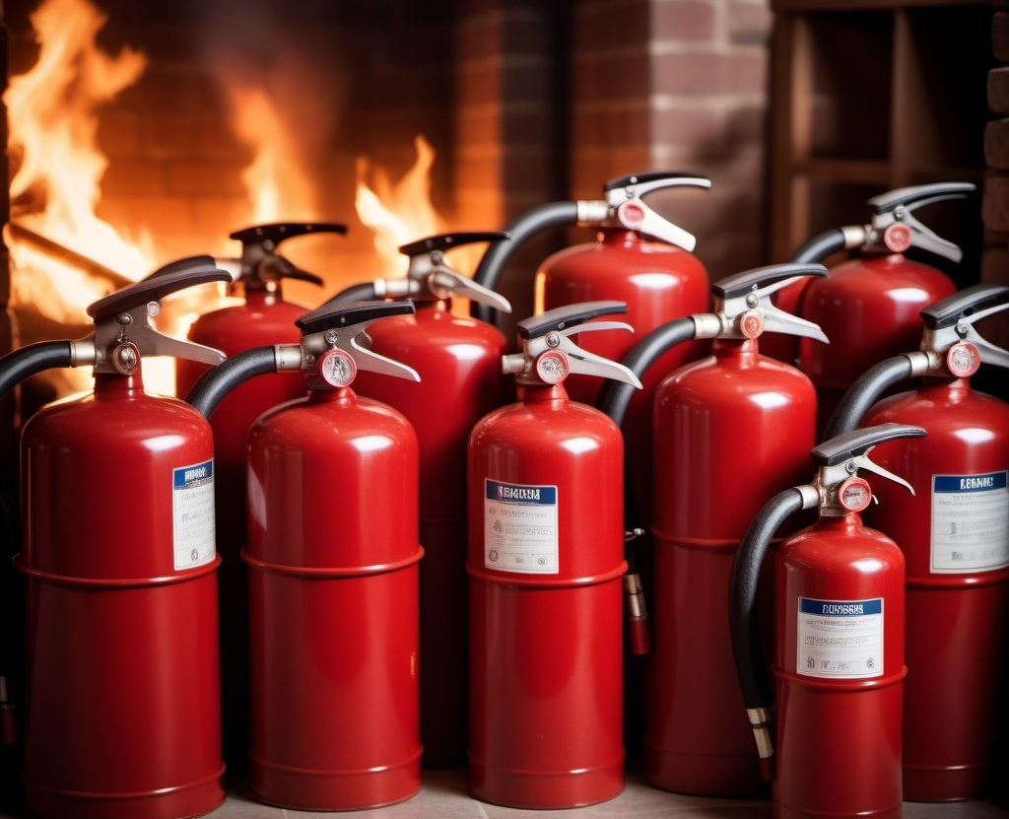
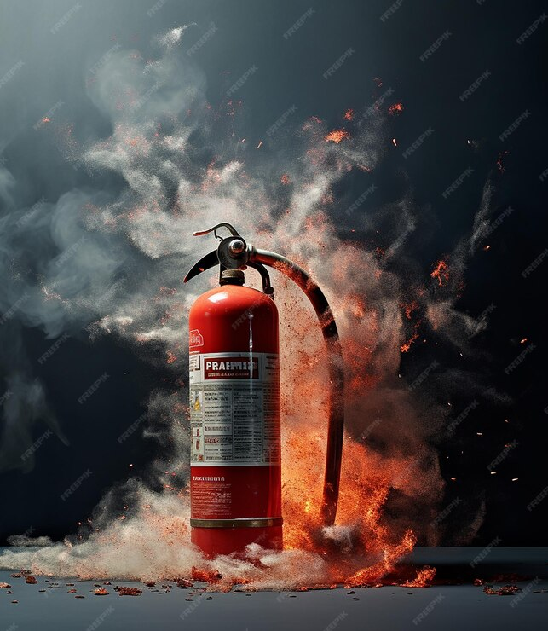
TYPES OF FIRE EXTINGUISHERS

Slide 23
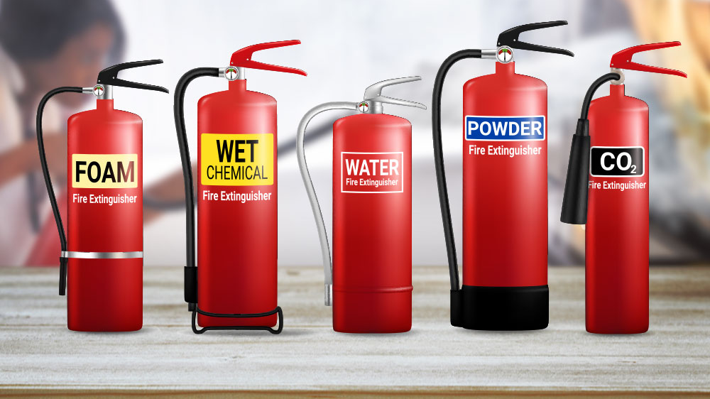
Different types of fire extinguishers exist in order to address the 5 different classes of fires. Each fire class describes the fuel or material a fire is burning or what caused it to start - therefore, using the right extinguisher is essential to put out the fire safely.

Slide 24
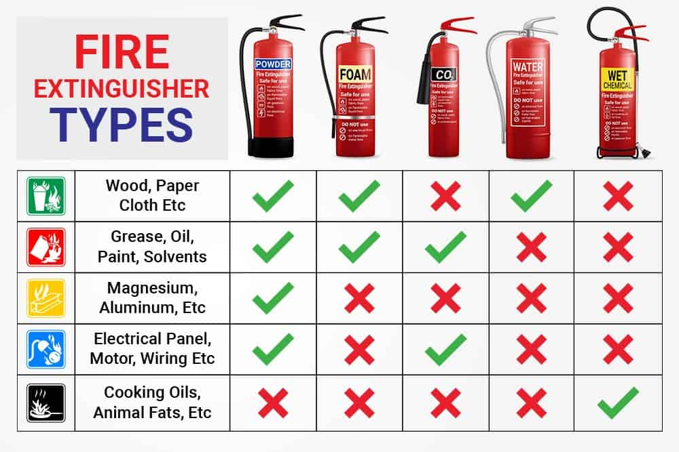

Slide 25
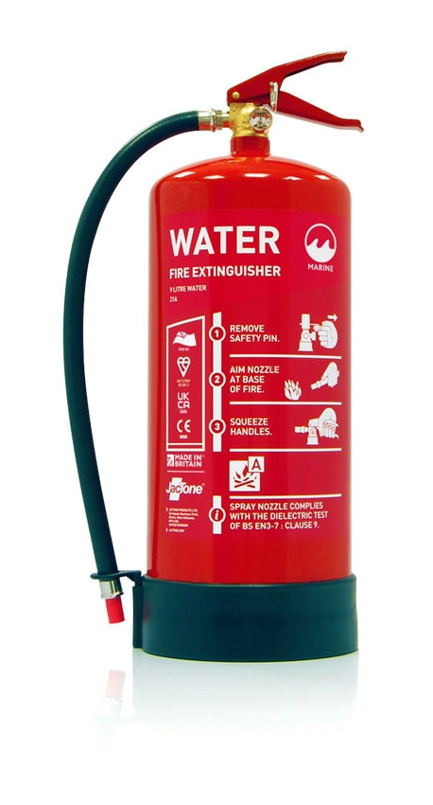
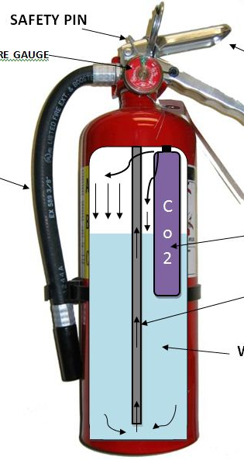
WATER
Water is the primary liquid used in these extinguishers.
A drawback for pure water fire extinguishers is that it is not suitable for use in freezing conditions since the water inside will freeze and render the extinguisher unusable.
Water type fire extinguishers which are designed also sometimes contain wetting agents fire.
Water mist extinguishers are a type of water fire extinguisher that uses distilled water and discharges it as a fine spray instead of a solid stream.
Water mist extinguishers are used where contaminants in unregulated water sources can cause excessive damage to personnel or equipment.
Typical applications include operating rooms, museums, and book collections.

Slide 26
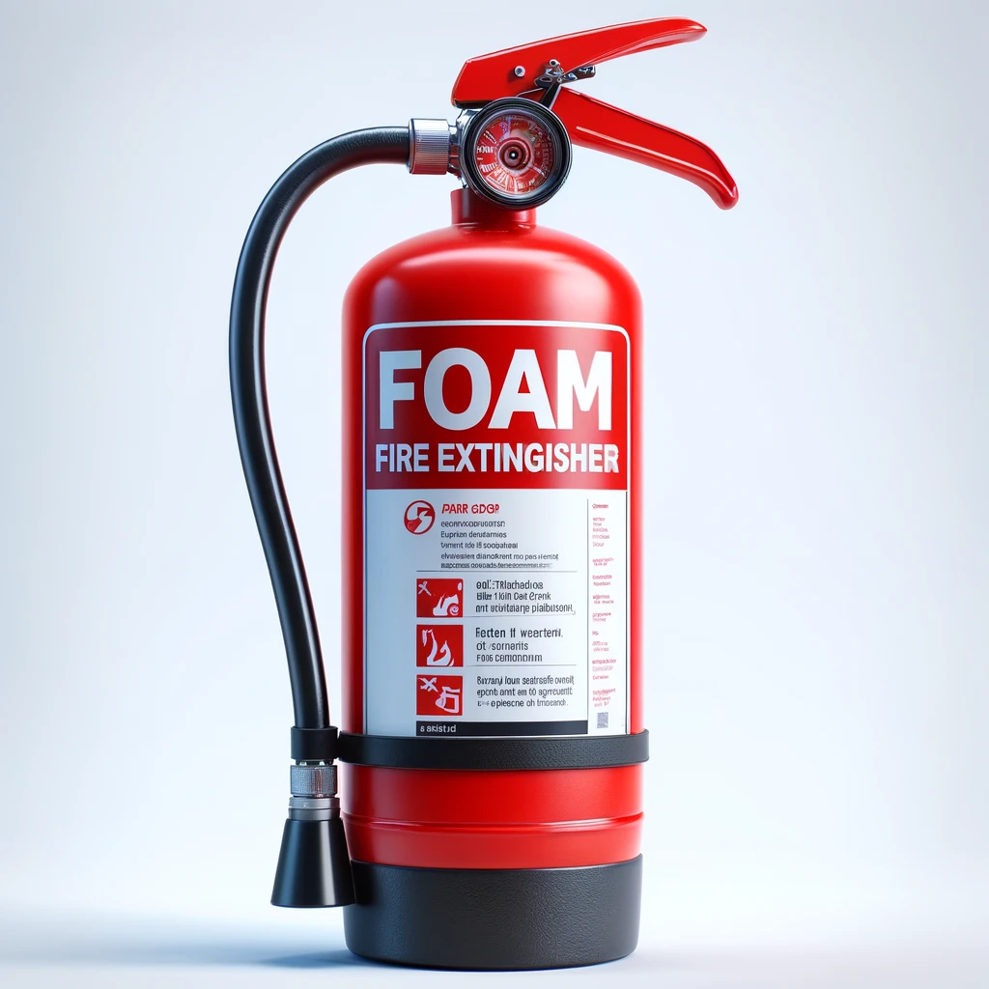
Film-forming foam type
AFFF (aqueous film-forming foam) and FFFP (film-forming fluoroprotein) fire extinguishers are rated for use on both Class A and Class B fires.
As the name implies, they discharge a foam material rather than a liquid or powder. They are not suitable for use in freezing temperatures.
An advantage of this type of extinguisher when used on Class B flammable liquid fires of appreciable depth is the ability of the agent to float on and secure the liquid surface, which helps to prevent reignition.

Slide 27
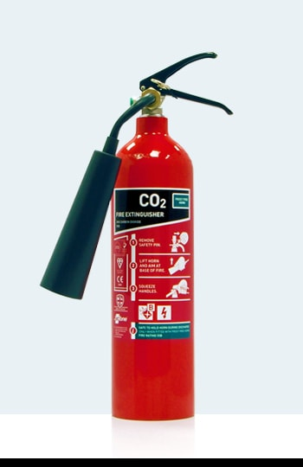
CO2 TYPE
The principal advantage of Carbon Dioxide (CO2) fire extinguishers is that the agent does not leave a residue after use. This can be a significant factor where protection is needed for delicate and costly electronic equipment.
Other typical applications are food preparation areas, laboratories, and printing or duplicating areas.
the agent is discharged in the form of a gas/snow cloud, it has a relatively short range of 3 ft to 8 ft (1 m to 2.4 m).
This type of fire extinguisher is not recommended for outdoor use where windy conditions prevail or for indoor use in locations
that are subject to strong air currents, extinguishment.
The concentration needed for fire extinguishment reduces the amount of oxygen in the vicinity of the fire and should be used with caution when discharged in confined spaces.

Slide 28
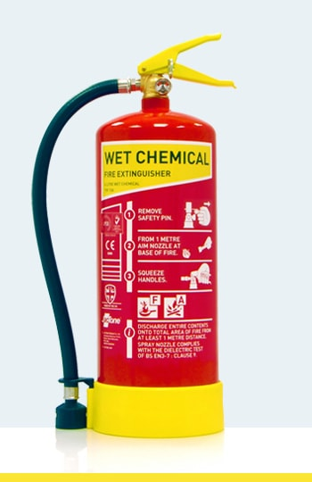
WET TYPE
The extinguishing agent can be comprised of, but is not limited to, solutions of water and potassium acetate, potassium carbonate, potassium citrate, or a combination of these chemicals (which are conductors of electricity).
The liquid agent typically has a pH of 9.0 or less.
On Class A fires, the agent works as a coolant. On Class K fires (cooking oil fires),forms a foam blanket to prevent reignition.
The water content of the agent aids in cooling and reducing the temperature of the hot oils and fats below their auto ignition point.
The agent, when discharged as a fine spray directly at cooking appliances, reduces the possibility of splashing hot grease and does not present a shock hazard to the operator.
Wet chemical extinguishers also offer improved visibility during firefighting as well as minimizing cleanup afterward.

Slide 29
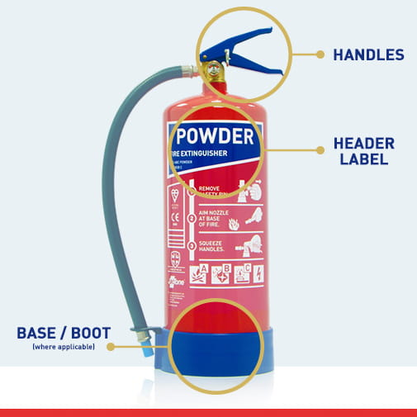
DRY POWDER TYPE
These fire extinguishers and agents are intended for use on Class D fires and specific metals, following special techniques and manufacturer's recommendations for use.
The extinguishing agent can be applied from a fire extinguisher or by scoop and shovel.
Using a scoop or shovel is often referred to as a hand propelled fire extinguisher.

Slide 30
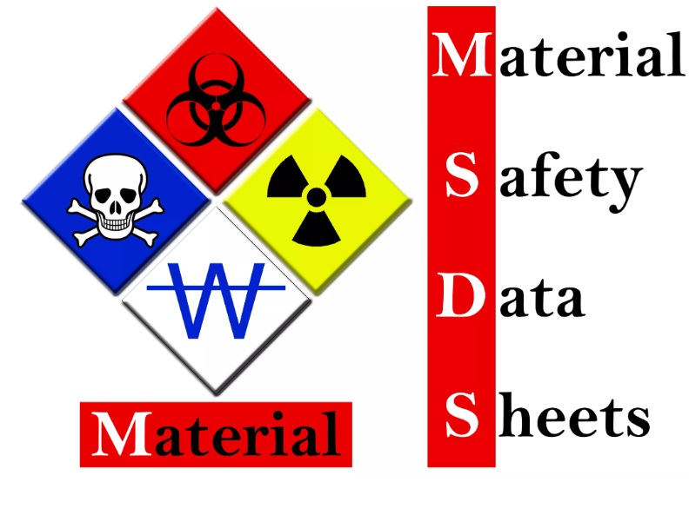
MATERIAL SAFETY DATA SHEETS (MSDS)
Material Safety Data Sheet (MSDS) is a document that contains information on the potential hazards (health, fire, reactivity and environmental) and how to work safely with the chemical product.
It is an essential starting point for the development of a complete health and safety program.
It also contains information on the use, storage, handling and emergency procedures all related to the hazards of the material.
The MSDS contains much more information about the material than the label. MSDSs are prepared by the supplier or manufacturer of the material.

Slide 31
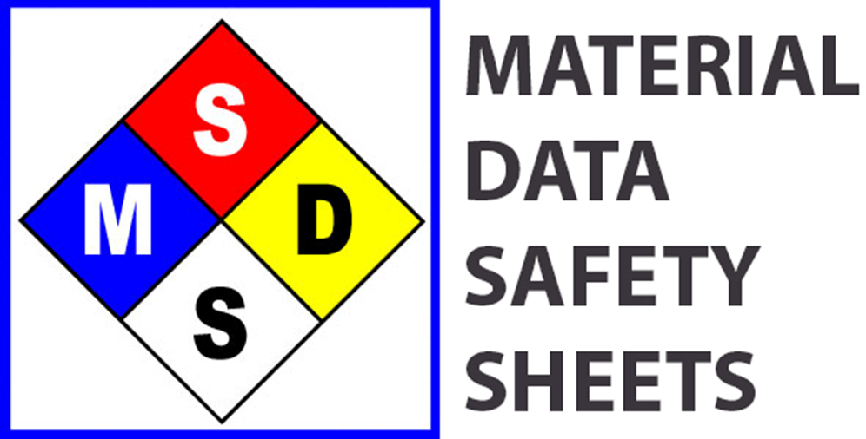
It is intended to tell what the hazards of the product are, how to use the product safely, what to expect if the recommendations are not followed, what to do if accidents occur, how to recognize symptoms of overexposure, and what to do if such incidents occur.
The purpose of a safety data sheet is to act as a quick reference for safely storing, handling, and transporting the chemical product.

Slide 32
The specific contents of the document vary depending on the nature of the substance and the manufacturer
It will, however, typically include the following information:
Product Information: product (name), manufacturer and suppliers names, addresses, and emergency phone numbers
Hazardous
Ingredients
Physical Data Fire or Explosion Hazard Data Reactivity Data: information on the chemical instability of a product and the substances it may react with
· Toxicological Properties: health effects
· Preventive Measures
· First Aid Measures Preparation Information: who is responsible for preparation and date of preparation of MSDS

Slide 33
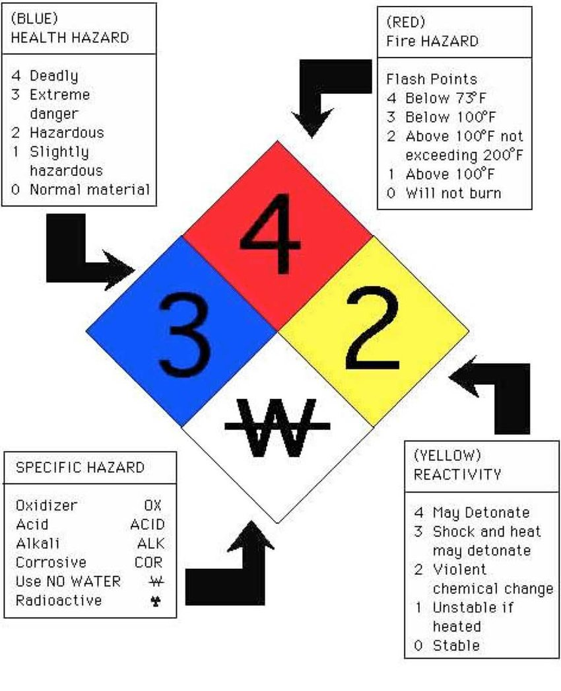

Slide 34
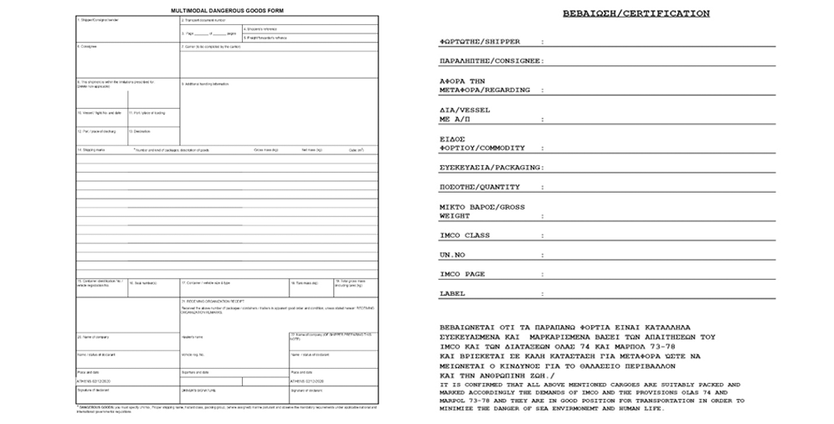

Slide 35
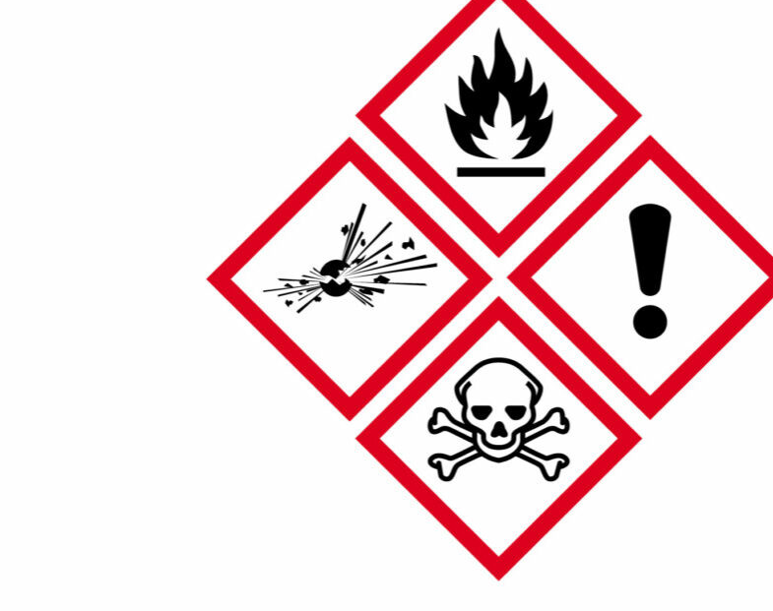
CONTROL OF CHEMICAL HAZARDS
A chemical hazard is any substance, regardless of its form- that can potentially cause physical and health hazards to people, or can result in harm to the environment. It can also be defined as the actual risk associated with specific chemicals, such as skin burns, long term negative impact to health, lasting environmental damage, fires, or even explosions

Slide 36
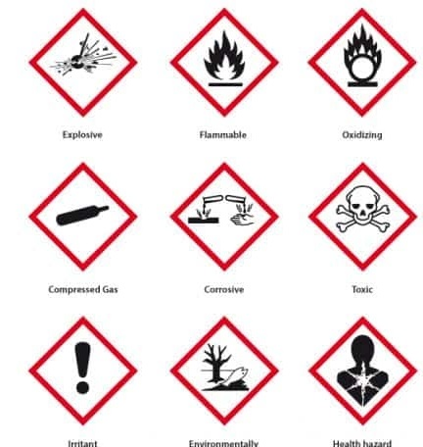
Types of Chemical Hazards

Slide 37
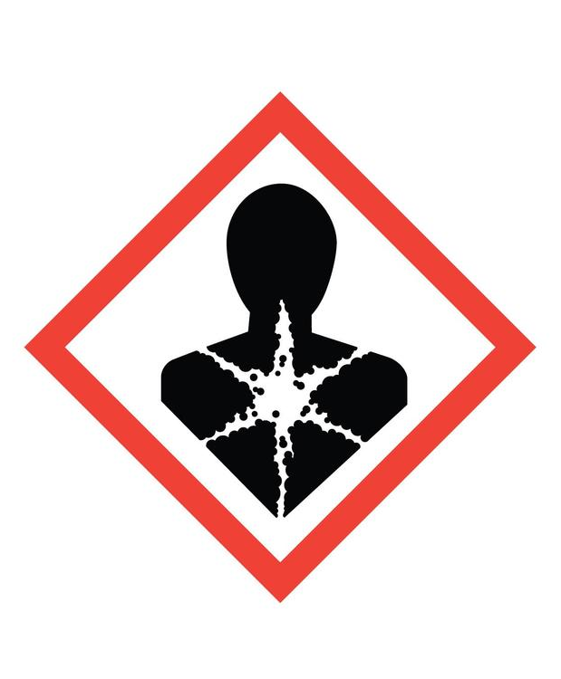
HEALTH HAZARD
:This symbol shows a person with damage Health hazard - and pertains to chemicals that can cause serious and long-term negative impacts on health.
Carcinogens are also substances that are known to be cancer-causing chemicals.
They are categorized as either natural or manmade, but it is crucial to note that even a small amount of this type of chemical can severely damage human health.

Slide 38
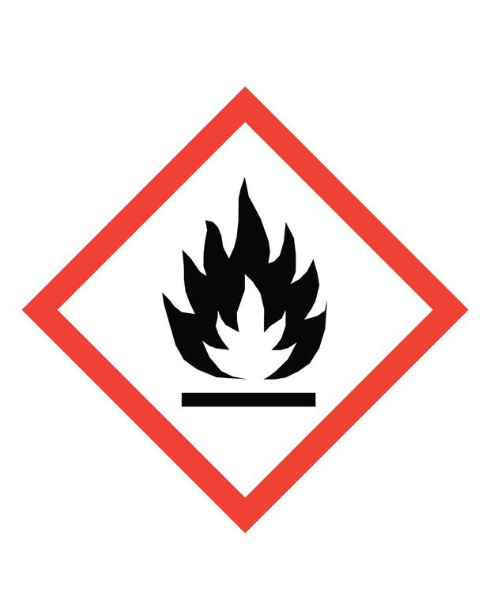
FLAMMABLE -
The symbol for this is a flame and it pertains to chemicals or highly flammable gases that may catch fire or ignite once exposed to air or other ignition sources or elements.

Slide 39

Irritant/hazardous/hazardous to the ozone layer
- This is symbolized by a big exclamation point and refers to chemicals that usually cause redness, rashes, or inflammation of the affected area.
Although the presence of symptoms is normally shortterm, there are still instances where they create long- lasting effects on others.
It is also known to either cause harm to individuals or pose a threat to public health by harming the ozone layer

Slide 40

Gas under pressure
- The symbol for this is a gas cylinder and it pertains to gases that are stored under pressure and may explode if heated or refrigerated gases that may cause burns or injury.
Gases stored under pressure, liquified gases, and dissolved gases; such as ammonia, liquid nitrogen, or acetylene.

Slide 41
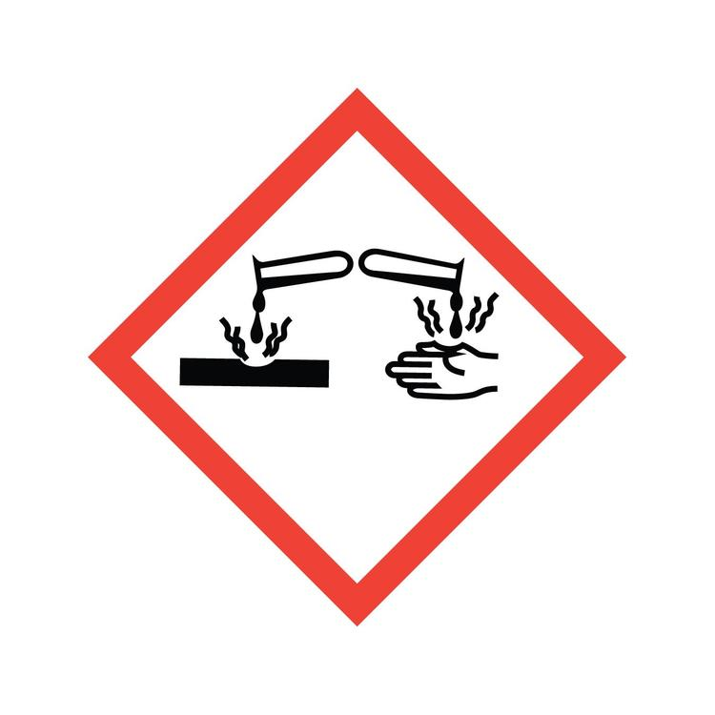
Corrosion
This pictogram shows corrosion of material and skin. It refers to chemicals that can cause severe skin burns and damage to the tissue once contacted with.
Materials causing skin corrosion/burns or eye damage on contact, or that are corrosive to metals.

Slide 42
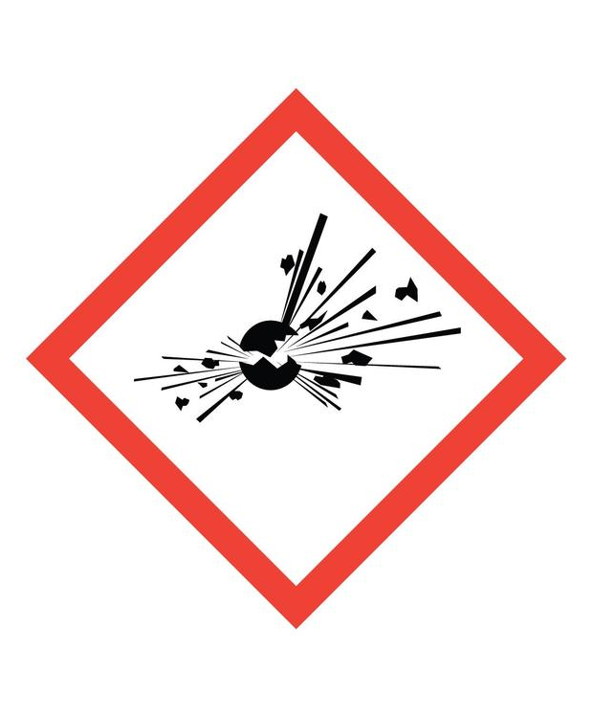
Explosives
- This is symbolized by an exploding bomb and pertains to chemicals that may explode or can cause a mass explosion.
Explosives, including organic peroxides and highly unstable material at risk of exploding even without exposure to air (self-reactives).

Slide 43
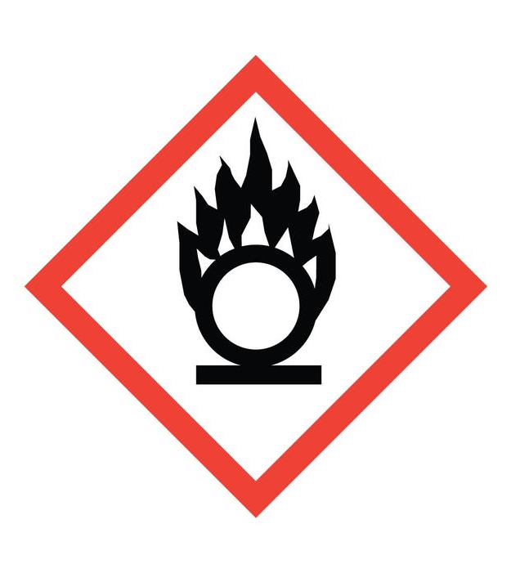
Oxidizers
- This pictogram shows a flame over a circle and symbolizes chemicals or substances that, under certain conditions or exposure to other chemicals or elements, can cause severe physical hazards such as fires or explosions.
Identifies oxidizers. Oxidizers are chemicals that facilitate burning or make fires burn hotter and longer.

Slide 44
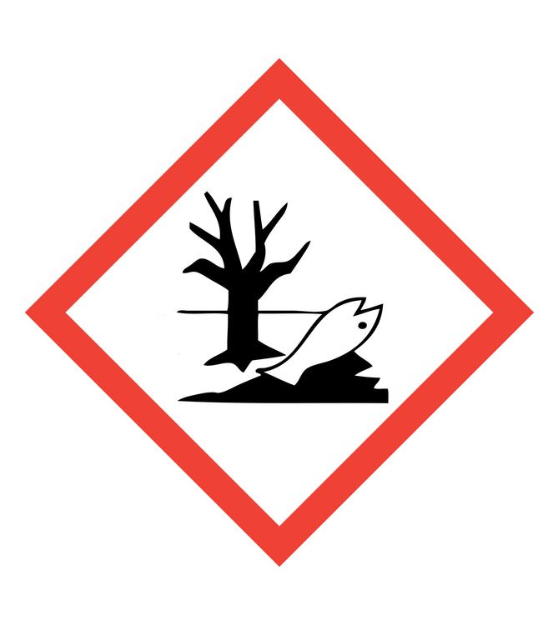
Hazardous to environment
– the symbol for this is a dead tree and fish. It refers to chemicals that can cause lasting damage to the environment
Chemicals toxic to aquatic wildlife

Slide 45
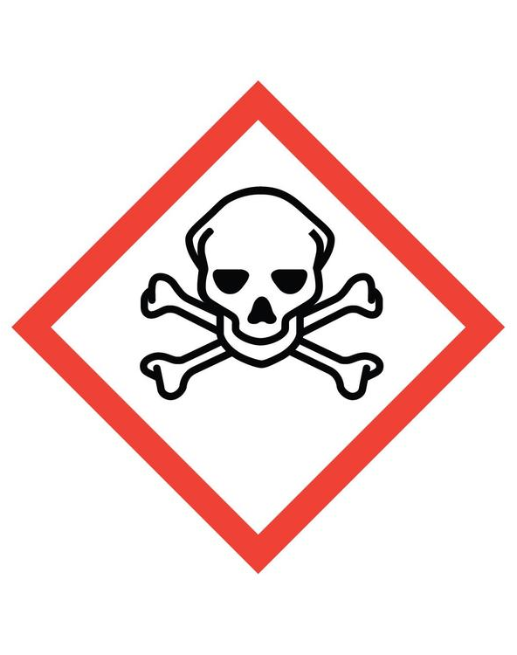
Toxic
- This pictogram shows a skull and crossbones, and symbolizes chemicals that even at a very low exposure-can cause irreversible changes or mutations to a person's DNA, damage to health, or even fatality.
Substances, such as poisons and highly concentrated acids, which have an immediate and severe toxic effect (acute toxicity).

Slide 46
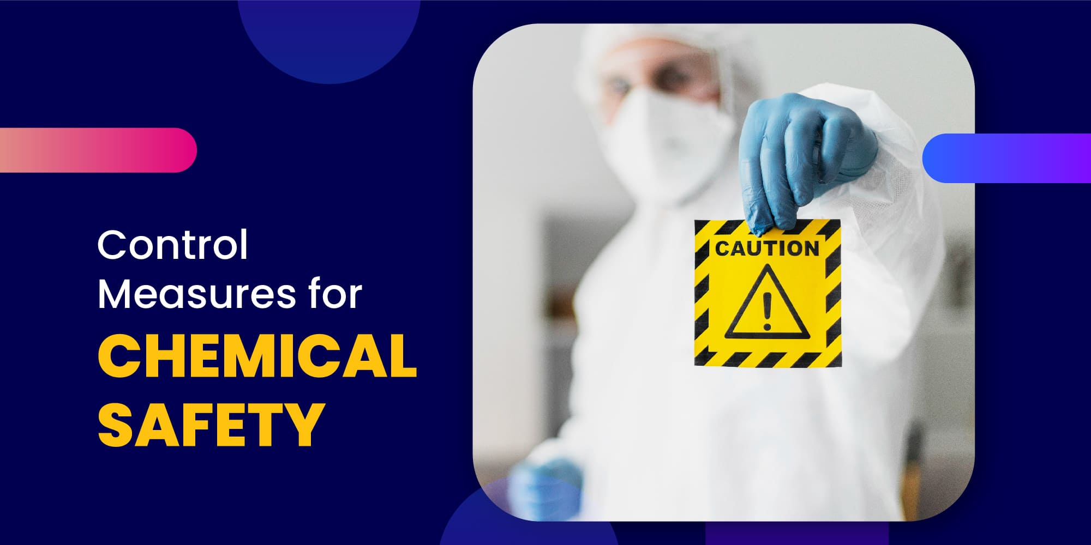

Slide 47
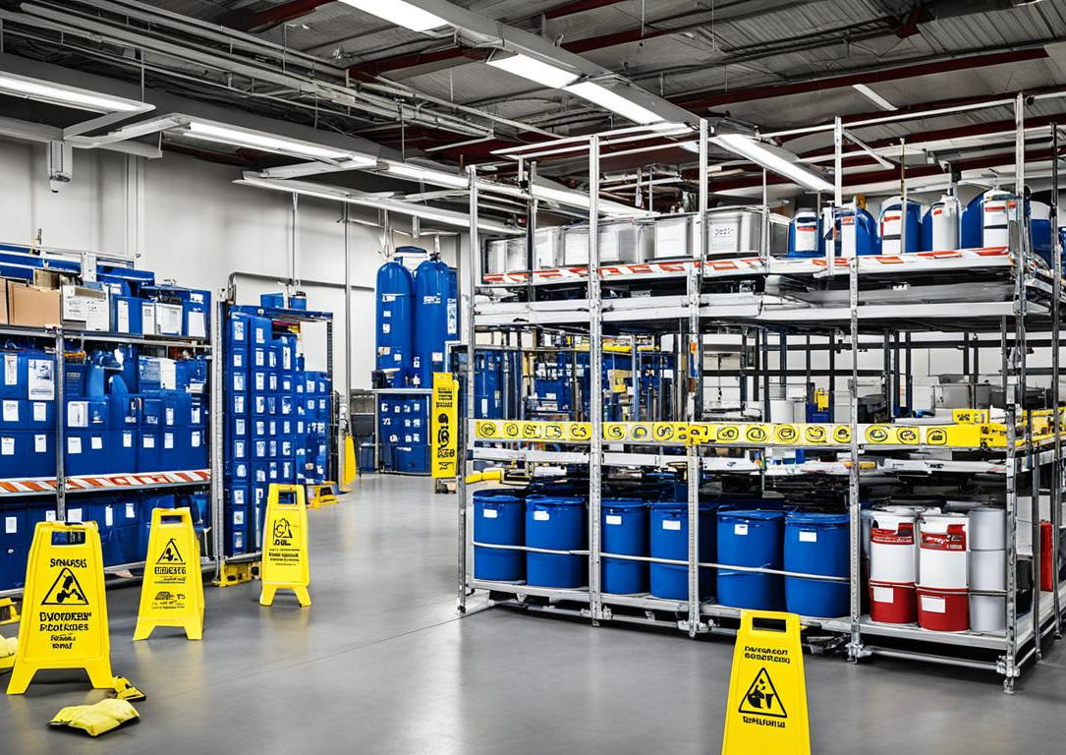
Controlling Chemical Hazards
Once the hazards involved in the handling and use of chemicals are identified, the next stage is to put control measures in place

Slide 48
Elimination : options which get rid of the hazard altogether
Substitution- Replacing a hazardous chemical with a less hazardous one wherever possible.
Engineering Controls- Fume Hoods, local exhaust ventilation, etc.
Administrative control- Standard Operating Procedures (SOP), caution signages, etc. •
Personal protective equipment- Lab coats, safety glasses,hand gloves, etc.

Slide 49
1. Elimination
The risk control measure that has the greatest level of effectiveness is elimination.
Before any other control measures are considered, elimination must be applied first.
Elimination is the method of totally removing a hazard or hazardous practice from the workplace.
Some examples of eliminating the use of a hazardous chemical in the workplace include:
• Eliminating the use of chemical adhesives by using fasteners such as screws or nails.
• Eliminating the use of flammable forklift gas by using electric power forklifts instead of LPG powered forklifts

Slide 50

2. Substitution
If we can't successfully eliminate the use of a hazardous chemical in our business, we must then try to substitute it.
Substitution is when we replace the use of a hazardous chemical with another chemical that is less hazardous and presents a lower level of risk.
Sometimes, substitution can be hard to achieve because the dangerous properties of hazardous chemicals are often what makes them very effective in manufacturing and chemical processes

Slide 51

3. Isolation
If it's not possible to substitute the use of a hazardous chemical with another chemical that is less hazardous, we must then isolate the hazardous chemical from people and other incompatible substances.
This can be done in a number of ways, for example:
If one part of a manufacturing process involves the use of a hazardous chemical, we could build a ventilated enclosure over this part of the manufacturing process.
This enclosure would stop the airborne contaminants from this area moving into other areas of the manufacturing facility where people are present.
The airborne contaminants that are generated inside this enclosure should be vented to the outside atmosphere in a safe location where people don't congregate.
If large quantities of hazardous chemicals are stored in the workplace, we could isolate these hazardous chemicals from people by storing them outdoors in a compliant chemical storage container.
Isolating hazardous chemicals from people by storing them outdoors reduces the risk of harm to people in the event of a workplace fire or chemical spill.

Slide 52

4. Engineering Controls
If isolation cannot be achieved, you can implement a range engineering controls to reduce the risk associated with hazardous chemicals. Of Engineering controls are physical in nature.
They are devices or processes that eliminate exposure to hazardous chemicals.
Engineering controls can be used to:
• Minimise the generation of hazardous chemicals
• Suppress or contain chemicals .
• Limit the area of contamination in the event of spills
Engineering controls can include devices such as mechanical ventilation systems,
compliant chemical storage containers or the automation of processes involving the use
of hazardous chemicals.

Slide 53

5. Administrative Controls
If there is still a chemical risk once higher order controls are implemented, then you must work to reduce this by developing administrative controls.
Administrative controls aren't as effective as other controls, because they don't control the hazard at its source.
Administrative controls rely on human behaviour and supervision, therefore, they aren't as consistent or reliable as other controls.
Administrative controls are generally written policies and procedures that outline the best work practices to minimise exposure to hazardous chemicals.

Slide 54

These policies can include things such as:
• Reducing the number of people exposed to hazardous chemicals
• Reducing the duration and frequency of exposure to hazardous chemicals
• Reducing the quantity of hazardous chemicals kept on site through inventory reduction methods such as just in time supply

Slide 55

6. Personal Protective Equipment
Personal protective equipment (PPE) should not be relied on to control risk.
Instead, PPE should only be used as a last resort when other more effective control measures have been used and the risk has not been eliminated.
PPE can also be used as interim protection until higher level controls are fully implemented.
PPE is also a useful way to supplement higher level controls when carrying out high-risk work such as spray painting and abrasive blasting.
Some examples of PPE can include:
• Chemical resistant glasses
• Face shields
• Protective clothing
• Chemical resistant gloves
• Shoe covers
• Respiratory equipment

Slide 56
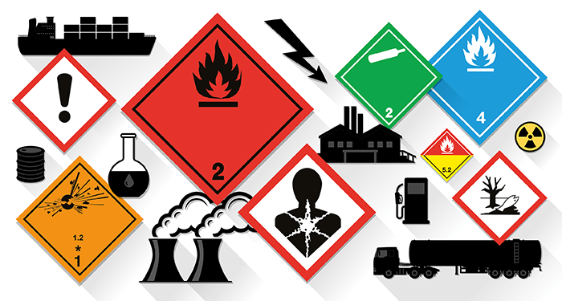
HAZARDOUS PROPERTIES OF CHEMICALS

Slide 57
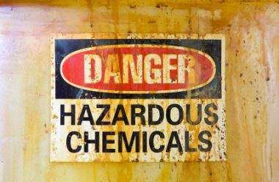
Chemical substances that have the ability to create a physical or health hazard are considered hazardous, Due to their may be but are n properties chemical hazardous substances may be, but are not limited to being toxic, explosive, flammable, self-reactive, oxidizing, or corrosive.
Exposure to these substances by different routes including inhalation, dermal absorption, or ingestion can lead to adverse health effects, enhancing the need to know about the hazards associated to these substances beforehand.

Slide 58
TOXIC
EXPLOSIVE
FLAMMABLE
SELF-REACTIVE
OXIDIZING
CORROSIVE

Slide 59

HAZARD & OPERABILITY STUDY (HAZOP)

Slide 60

A HAZOP is a systematic assessment tool used to identify and address potential hazards in industrial processes before an incident occurs that could affect the Safety of people or assets while hindering Productivity.
HAZOP studies are typically performed while new facilities are being designed and constructed, when new processes are added or when processes change.
Most regulatory agencies also require periodic HAZOP studies on existing processes.
The HAZOP assessment is typically performed by a small team that breaks each step of a process down for individual review to identify potential deviations from the original process design.
Like all PHAs, HAZOPs go beyond the review of how a process is supposed to operate in order to identify unintended outcomes and explore their potential ripple effects on health and safety.

Slide 61
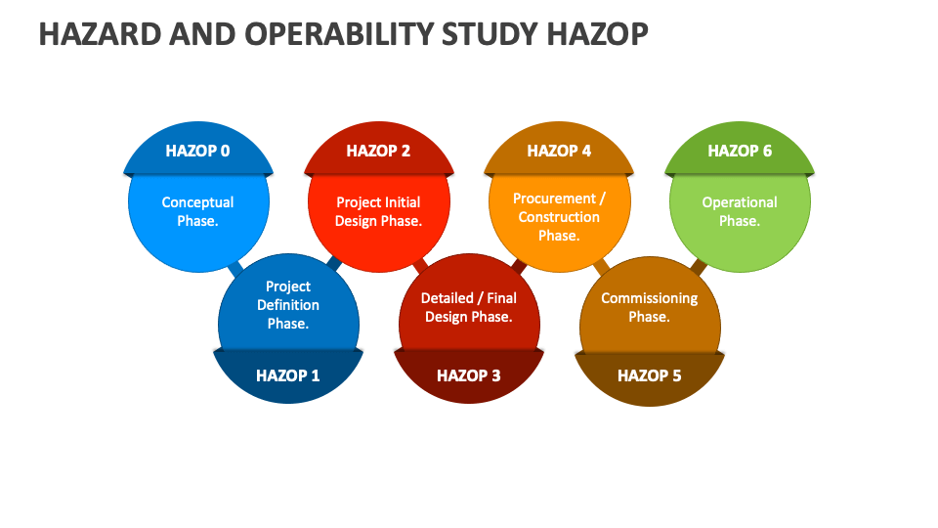

Slide 62
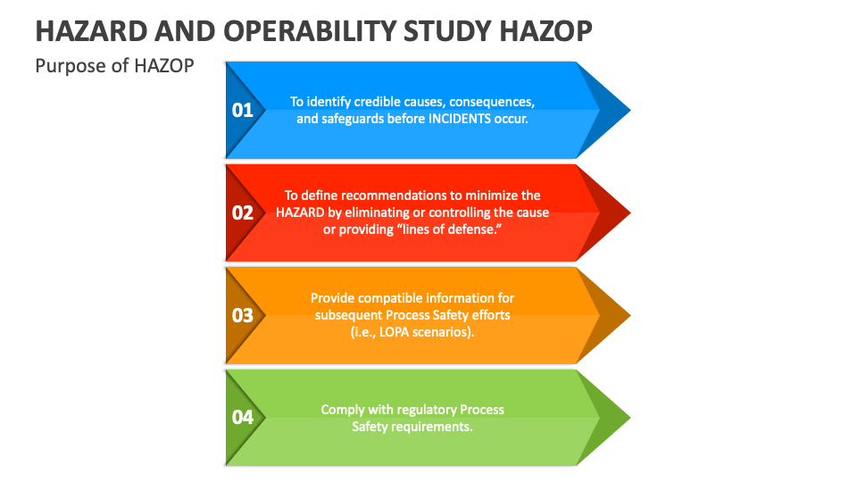

Slide 63
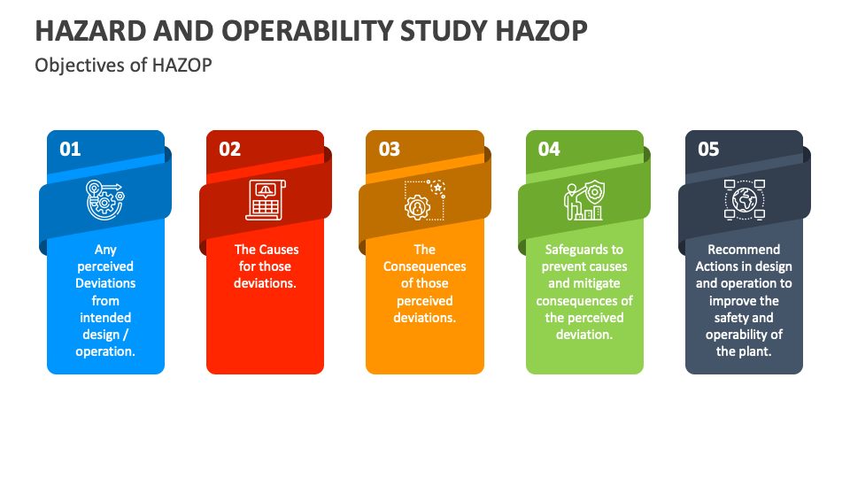

Slide 64
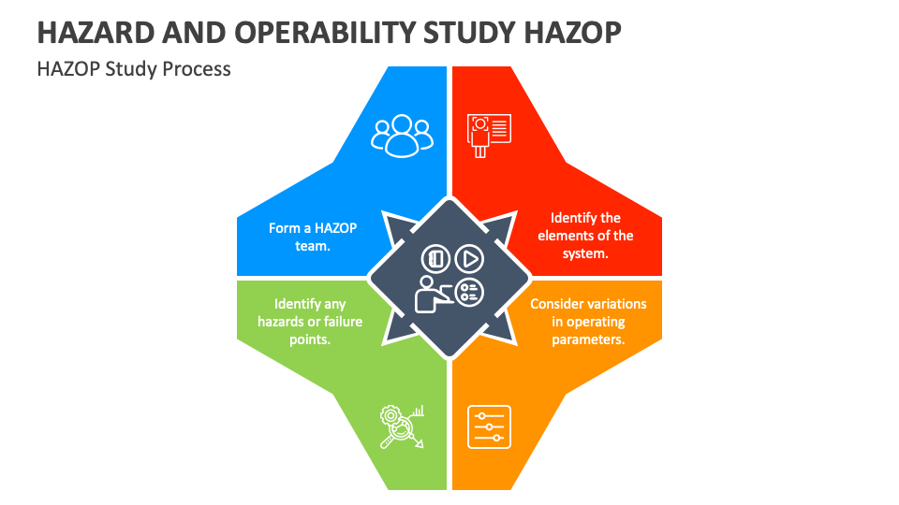

Slide 65
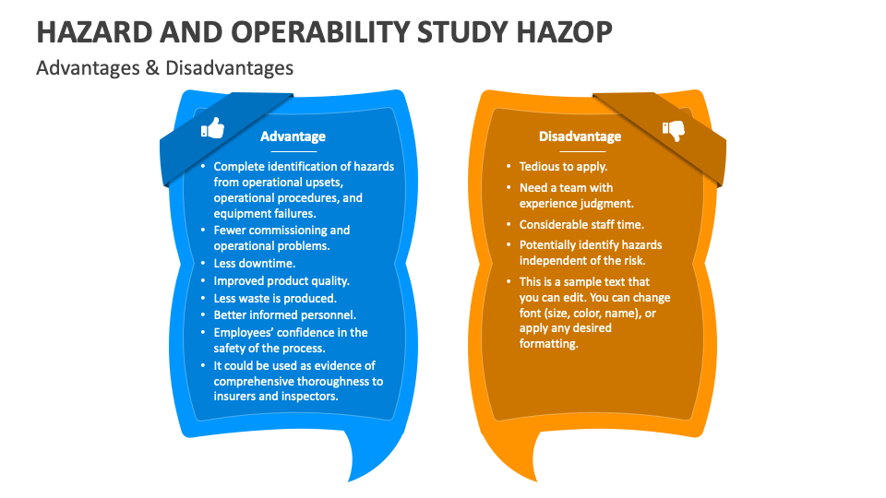

Slide 66

The HAZOP Study Process
The goal is to find potential situations that would cause that element to pose a hazard or limit the operability of the process as a whole. There are four basic steps to the process:
1. Forming a HAZOP team
2. Identifying the elements of the system
3. Considering possible variations in operating parameters
4. Identifying any hazards or failure points

Slide 67

1. Form a HAZOP Team
To perform a HAZOP, a team of workers is formed, including people with a variety of expertise such as operations, maintenance, instrumentation, engineering/process design, and other specialists as needed.
These should not be "newbies, but people with experience, knowledge, and an understanding of their part of the system.
The key requirements are a understanding of the system, and a willingness to consider all reasonable variations at each point in the system.

Slide 68
2. Identify Each Element and its Parameters
The HAZOP team will then create a plan for the complete work process, identifying the individual steps or elements.
This typically involves using the piping and instrument diagrams (P&ID), or a plant model, as a guide for examining every section and component of a process.
For each element, the team will identify the planned operating parameters of the system at that point: flow rate, pressure, temperature, vibration, and so on.

Slide 69
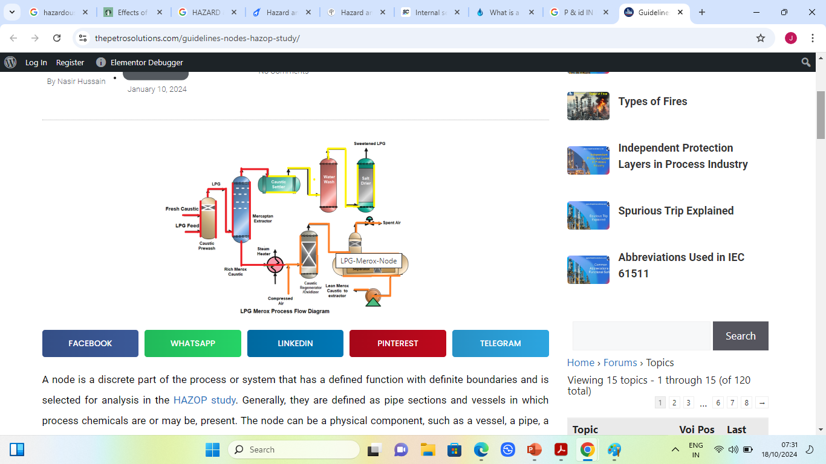

Slide 70
3. Consider the Effects of Variation
For each parameter, the team considers the effects of deviation from normal.
For example,
"What would happen if the pressure at this valve was too high?
What if the pressure was unexpectedly low?
Would the rate of change in pressure (delta- p) pose its own problems here?"
Don't forget to consider the ways that each element interacts with others over time; for example,
"What would happen if the valve was opened too early, or too late?"

Slide 71
4. Identify Hazards and Failure Points
Where the result of a variation would be a danger to workers or to the production process, we've found a potential problem.
Document this concern, and estimate the impact of a failure at that point.
Then, determine the likelihood of that failure; is there a real cause for the harmful variation?
Evaluate the existing safeguards and protection systems, and evaluate their ability to handle the deviations that we've considered.

Slide 72

Results of a HAZOP Study
Because HAZOP is a mental exercise, it can be implemented as part of the planning of a new work process, even before a facility is built.
Existing facilities and processes can also be assessed with HAZOP.
Where a HAZOP study is performed in the planning stage of a new process, completing the study means that all potential causes of failure will be identified.
The HAZOP team will write an assessment weighing the potential deviations, their consequences, their causes, and the protection requirements.
From this point, changes to the plan can be made to prevent problems from arising, or to mitigate their effects.

Slide 73
In existing facilities, a HAZOP may be ongoing, working to improve the process without a any specific end date. Instead of a single, large assessment, the study's results will be released a as a stream of action items, as each problem is identified and a solution is created.
In both cases, when a hazardous condition is identified, recommendations may be made for process or system modifications, or further study by a specialist may be required. A
HAZOP study might recommend these typical actions:
• A review of existing protection system designs by a specialist
• Adding or modifying alarms that warn of deviations
• Adding or modifying relief systems
• Adding or modifying ventilation systems
• Increasing sampling and testing frequency

Slide 74
. Instead of a single, large assessment, the study's results will be released a as a stream of action items, as each problem is identified and a solution is created.
In both cases, when a hazardous condition is identified, recommendations may be made for process or system modifications, or further study by a specialist may be required.
A HAZOP study might recommend these typical actions:
· A review of existing protection system designs by a specialist
· Adding or modifying alarms that warn of deviations
· Adding or modifying relief systems
· Adding or modifying ventilation systems
· Increasing sampling and testing frequency

Slide 75
THE DOW FIRE AND EXPLOSION HAZARD
It is a method for ranking the relative fire and explosion risk associated with a process.
The index is developed by the Dow Chemical Company and published by the American Institute of Chemical Engineering, Dow (1994) (www.aiche.org), evaluating the potential risk from a process and assessing the potential loss.
A numerical "Fire and explosion index" (F&EI) is calculated, based on the nature of the process and the properties of the process materials.
The larger value of the F&EI, the more hazardous the process.
Objectives of dow fire and explosion index
Quantify: The expected damage potential due to fire & explosion incidents in realistic terms
Identify: Equipment that is likely to contribute to the creation or escalation of an incident

Slide 76

STRUCTURE OF HAZARD IDENTIFICATION AND RISK ASSESSMENT
One of the "root causes" of workplace injuries, illnesses, and incidents is the failure to identify or recognize hazards that are present, or that could have been anticipated.
A critical element any effective safety and health program is a proactive, ongoing process to identify and assess such hazards.

Slide 77
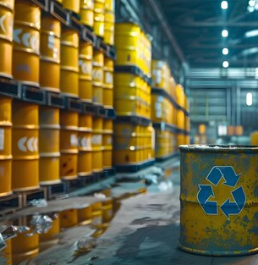
To identify and assess hazards, employers and workers:
• Collect and review information about the hazards present
• Collect or likely to be present in the workplace.
• Conduct initial and periodic workplace inspections of the workplace to identify new or recurring hazards.
• Investigate injuries, illnesses, incidents, and close calls/near misses to determine the underlying hazards, their causes, and safety and health program shortcomings.
• Group similar incidents and identify trends in injuries, illnesses, and hazards reported.
• Consider hazards associated with emergency or non routine situations.
• Determine the severity and likelihood of incidents that could result for each hazard identified, and use this information to prioritize corrective actions.

Slide 78
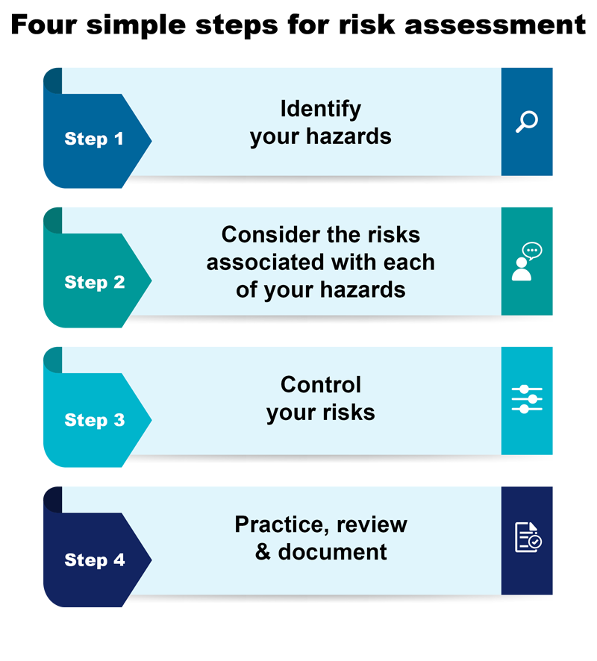
STEPS OF RISK ASSESSMENT

Slide 79



Slide 80
Action item 1: Collect existing information about workplace hazards
Information on workplace hazards may already be available to employers and workers, from both internal and external sources.

Slide 81
How to accomplish it
Collect, organize, and review information with workers to determine what types of hazards may be present and which workers may be exposed or potentially exposed.

Slide 82
Information available in the workplace may include:
· Equipment and machinery operating manuals.
· Safety Data Sheets (SDS) provided by chemical manufacturers.
· Self-inspection reports and inspection reports from insurance carriers, government agencies, and consultants.
· Records of previous injuries and illnesses.
· Workers' compensation records and reports.
· Patterns of frequently-occurring injuries and illnesses.
· Exposure monitoring results, industrial hygiene assessments, and medical records (appropriately redacted to ensure patient/worker privacy).
· Existing safety and health programs (lockout/tagout, confined spaces, process safety management, personal protective equipment, etc.).
· Input from workers, including surveys or minutes from safety and health committee meetings.
· Results of job hazard analyses, also known as job safety analyses.

Slide 83
Information about hazards may be available from outside sources, such as:
· National Safety Council, and Department of Labour & Employment websitespublications, and alerts.
· Trade associations.
· Labor unions, state and local occupational safety and health committees/coalitions and worker advocacy groups.
· Safety and health consultants.

Slide 84
Action item 2: Inspect the workplace for safety hazards
Hazards can be introduced over time as workstations and processes change, equipment or tools become worn, maintenance is neglected, or housekeeping practices decline.
Setting aside time to regularly inspect the workplace for hazards can help identify shortcomings so that they can be addressed before an incident occurs.

Slide 85
How to accomplish it
· Conduct regular inspections of all operations, equipment, work areas and facilities. Have workers participate on the inspection team and talk to them about hazards that they see or report
Be sure to document inspections so we can later verify that hazardous conditions are corrected.
Take photos or videos of problem areas to facilitate later discussion and brainstorming about how to control them, and for use as learning aides.
· Include all areas and activities in these inspections, such as storage and warehousing, facility and equipment maintanence, purchasing and office functions, and the activities of on-site contractors, sub contractors and temporary employees.
· Regularly inspect both plant vehicles (e.g., forklifts, powered industrial trucks) and transport vehicles (e.g., cars, trucks).
· Use checklists that highlight things to look for

Slide 86
Typical hazards fall into several major categories, such as those listed below; each workplace will have its own list:
o General housekeeping
o Slip,trip,fall hazards
o Electrical hazards
o Fire protection
o Work organization and process flow (including staffing and scheduling)
o Work practices
o Workplace violence
o Equipment operation
o Equipment maintenance
o Ergonomic problems
o Lack of emergency procedures

Slide 87
Note: Many hazards can be identified using common knowledge and available tools. For Example, we can easily identify and correct hazards associated with broken stair rails and frayed electrical cords. Workers can be a very useful internal resource, especially if they are trained in how to identify and assess

Slide 88
Action item 3: Identify health hazards
Identifying workers' exposure to health hazards is typically more complex than identifying physical safety hazards.
For example, gases and vapors may be invisible, often have no odor, and may an immediately noticeable harmful health effect. Health hazards include chemical hazards (solvents, adhesives, paints, toxic dusts, etc.), physical hazards (noise, radiation, heat, etc.), biological hazards (infectious diseases), and ergonomic risk factors (heavy lifting, repetitive motions, vibration). Reviewing workers' medical records (appropriately redacted to ensure patient/worker privacy) can be useful in identifying health hazards associated with workplace exposures

Slide 89
How to accomplish it
Identify chemical hazards -review SDS and product labels to identify chemicals in the workplace that have low exposure limits, are highly volatile, or are used in large quantities or in unventilated spaces.
Identify activities that may result in skin exposure to chemicals.
• Identify physical hazards -identify any exposures to excessive noise (areas where we must raise our voice to beheard by others), elevated heat (indoor and outdoor), or sources of radiation (radioactive materials, X-rays, or radiofrequency radiation).
• Identify biological hazards -determine whether workers may be exposed to sources of infectious diseases, molds, toxic or poisonous plants, or animal materials (fur or scat) capable of causing allergic reactions or occupational asthma.
• Identify ergonomic risk factors -examine work activities that require heavy lifting, work above shoulder height, repetitive motions, or tasks with significant vibration.
• Conduct quantitative exposure assessments –when possible, using air sampling or direct reading instruments.
• Review medical records -to identify musculoskeletal injuries, skin irritation or dermatitis, hearing loss, or lung disease that may be related to workplace exposures

Slide 90
Action item 4: Conduct incident investigations
Workplace incidents -including injuries, illnesses, close calls/near misses, and reports of other concerns- provide a clear indication of where hazards exist.
By thoroughly investigating incidents and reports, we can identify hazards that are likely to cause future harm.
The purpose of an investigation must always be to identify the root causes (and there is often more than one) of the incident or concern, in order to prevent future occurrences.

Slide 91
How to accomplish it
• Develop a clear plan and procedure for conducting incident investigations, so that an investigation can begin immediately when an incident occurs. The plan should cover items such as:
o Who will be involved
o Lines of communication
o Materials, equipment, and supplies needed
o Reporting forms and templates
• Train investigative teams on incident investigation techniques, emphasizing objectivity and open- mindedness throughout the investigation process.
• Conduct investigations with a trained team that includes representatives of both management and workers.
• Investigate close calls/near misses.
• Identify and analyze root causes to address underlying program shortcomings that allowed the incidents to happen.
• Communicate the results of the investigation to managers, supervisors, and workers to prevent recurrence.

Slide 92
Action item 5: Identify hazards associated with emergency and nonroutine situations
Emergencies present hazards that need to be recognized and understood. Nonroutine or infrequent tasks, including maintenance and startup/shutdown activities, also present potential hazards.
Plans and procedures need to be developed for responding appropriately and safely to hazards associated with foreseeable emergency scenarios and nonroutine situations.

Slide 93
How to accomplish it
• Identify foreseeable emergency scenarios and nonroutine tasks, taking into account the types of material and equipment in use and the location within the facility. Scenarios such as the following may be foreseeable:
▪ Fires and explosions
▪ Chemical releases
▪ Hazardous material spills
▪ Startups after planned or unplanned equipment shutdowns
▪ Nonroutine tasks, such as infrequently performed maintenance activities
▪ Structural collapse
▪ Disease outbreaks
▪ Medical emergencies
▪ Weather emergencies & natural disasters
▪ Workplace violence

Slide 94
Action item 6: Characterize the nature of identified hazards, identify interim control measures, and prioritize the hazards for control
The next step is to assess and understand the hazards identified and the types of incidents that could result from worker exposure to those hazards.
This information can be used to develop interim controls and to prioritize hazards for permanent control.

Slide 95
How to accomplish it
· Evaluate each hazard by considering the severity of potential outcomes, the likelihood that an event or exposure will occur, and the number of workers who might be exposed.
Use interim control measures to protect workers until more permanent solutions can be implemented.
· Prioritize the hazards so that those presenting the greatest risk are addressed first. Note, however, that employers have an ongoing obligation to control all serious recognized hazards and to protect workers

Slide 96
"Risk"
The product of hazard and exposure. Thus, risk can be reduced by controlling or eliminating the hazard or by reducing workers' exposure to hazards. An assessment of risk helps employers understand hazards in the context of their own workplace and prioritize hazards for permanent control.

Slide 97

RISK ASSESSMENT TOOLS

Slide 98
Risk assessment tools, sometimes called "risk assessment techniques," are procedures or frameworks that can be used in the process of assessing and managing risks.
There are many ways to assess risk, making risk assessment tools flexible and
There are four commonly used risk assessment tools in different businesses.
All of them are used often and are easily applicable to different situations.

Slide 99

THE TOOLS ARE
1. Risk matrix
2. Failure Mode and Effects Analysis (FMEA)
3. Decision Tree
4. Bowtie Mode

Slide 100

Risk Matrix
A risk matrix is a tool used to assess and visualize the likelihood and severity of potential risks to a project or activity.
Risk matrices are often color-coded to help identify the highest risks, which are represented in red, moderate risks in orange or yellow, and low risks in green.
The matrix has two axes: one for the likelihood of a risk, and the other for its severity.
It's a key part of the risk assessment process, which involves identifying, analyzing, and evaluating risks
A risk matrix is a visual representation of risks laid out in a diagram or a table, hence its alternate name as a risk diagram.
Here, risks are divided and sorted based on their probability of happening and their effects or impact.
A risk matrix is often used to help prioritize which risk to address first, what safety measures and risk mitigation plans to take, and how a certain task should be done.
Risk matrices can come in any size and number of columns and rows, risk matrix depending on the project and risks being discussed

Slide 101


Slide 102

FMEA
The Failure Mode and Effects Analysis (FMEA) risk assessment tool was first discovered in the 1940s by the US military to identify all possible issues or failures in a design, process, product, and service.
Failure Mode and Effects Analysis (FMEA) is a systematic method for identifying and addressing potential failures in a process or product.
It's a proactive risk assessment tool that can help prevent costly issues, improve quality, and increase customer satisfaction
This tool is often used during a product or service's design or proposal stage to actively study possible risks and discover their effects.
FMEA has two parts to it:
• Failure Modes: the failures, problems, and issues that occur
• Effects Analysis: the analysis of the failures' effects

Slide 103


Slide 104
8 STEPS OF FMEA
Create a team of employees who have collective knowledge or experience with the system, design or process and customer needs. This includes employees with experience in customer service, design, maintenance, manufacturing, quality, reliability, testing and sales.
Identify the scope of the system, design, process, product or service. Define the purpose of the system process, service and design.
Break down a system, design or process into its different components.
Go through system, design or process elements to determine each possible issue or single point of failure.
Analyze the potential causes of those failures as well as the effects the failures would have.
Rank each potential failure effect based on decided criteria such as severity, likelihood of occurrence and probability of being detected. Organizations can use a risk priority number to score a system, design or process for risk potential.
Determine how to detect, minimize, mitigate and solve the most critical failures. This helps keep failure effect risks low by creating a list of potential failures and corrective actions to take.
Revise risk levels as needed.

Slide 105


Slide 106
Decision Tree
The decision tree risk assessment tool works by providing project managers a template to calculate and visualize the values of different results and the likelihood of achieving them.
In some cases, a decision tree is also often used to help calculate the value of a project, product, or service.
To use this tool, one starts with one element, product, or service they want to evaluate, and then creates different branches from it with different goals. When carried out, the final product looks like a flowchart similar to a tree with different branches, hence the name.

Slide 107


Slide 108


Slide 109
Bowtie Model
The Bowtie Model risk assessment tool aims to show the causal links between different sources of risks and their consequences.
The left side of the diagram shows what causes the risk, the right shows their potential outcomes, and then both sides meet in the middle with a single risk called "Event."
The left and right sides of the Event are larger and wider as many sources may lead to different consequences, but still be centered around one risk.
When drawn out, the model starts to look like a bowtie

Slide 110


Slide 111


Slide 112


Slide 113


Slide 114


Slide 115


